Slide 1
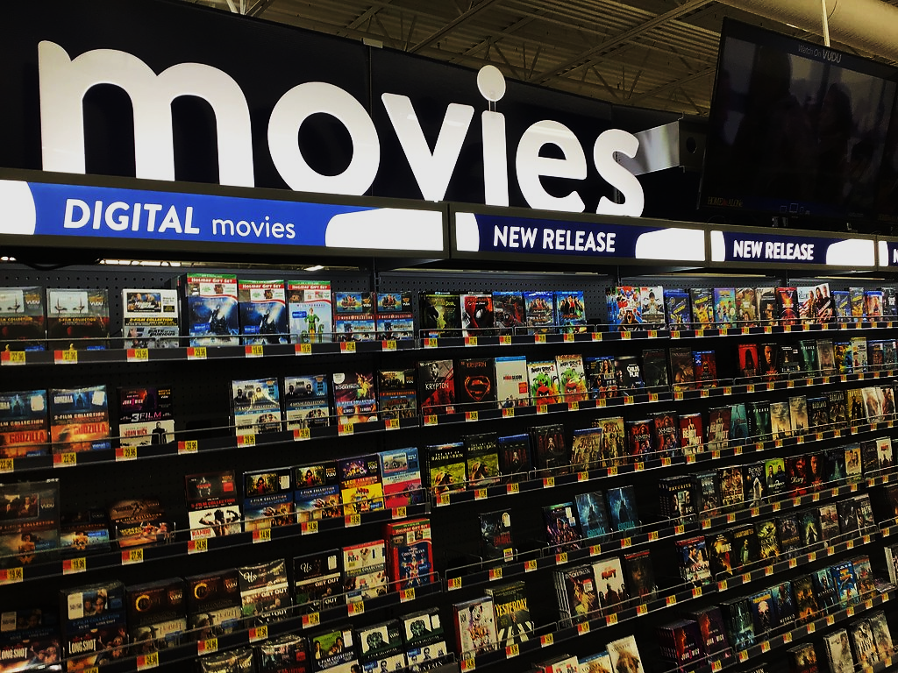
CAPSTONE PROJECT
SAKILA DVD RENTAL STORE
CHAKIT VERMA

Slide 2

TOPICS
Project Overview
Information about Dataset tables
Data cleaning and MECE-Breakdown
Solving Power Bi and EDA Questions
Dashboard Analysis
Conclusion

Slide 3

Project Overview
The Sakila DVD Rental Store data analysis project aims to uncover customer preferences, rental trends, and revenue drivers through thorough data exploration and advanced analytics techniques. By leveraging the dataset, insights will be derived to optimize operations, enhance customer satisfaction, and inform strategic decisions for business growth. Tools such as MySQL, Excel, and visualization software like Power BI will be utilized to conduct the analysis and present findings effectively.

Slide 4

Information about Dataset tables
Actor : The actor table lists information for all actors.
Address : The address table contains address information for customers, staff, and stores.
Category : The category table lists the categories that can be assigned to a film.
City : The city table contains a list of cities.
Country : The country table contains a list of countries.
Customer : The customer table contains a list of all customers.
Film : The film table is a list of all films potentially in stock in the stores.
Film actor : The film_actor table is used to support a many-to-many relationship between films and actors.
Film category : The film_category table is used to support a many-to-many relationship between films and categories.
Inventory : The inventory table contains one row for each copy of a given film in a given store.
Language : The language table is a lookup table listing the possible languages that films can have for their language and original language values.
Payment : The payment table records each payment made by a customer, with information such as the amount and the rental being paid for.
Rental : The rental table contains one row for each rental of each inventory item with information about who rented what item, when it was rented, and when it was returned.
Staff : The staff table lists all staff members, including information for email address, login information, and picture.
Store : The store table lists all stores in the system.

Slide 5

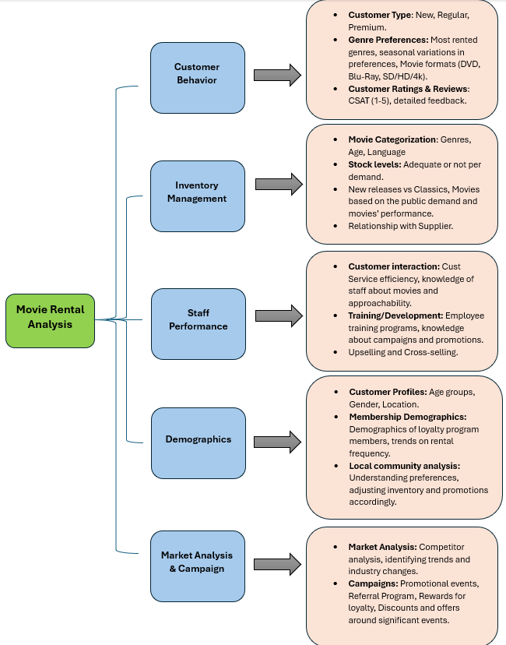
Data cleaning and MECE-Breakdown
The Table contains many null value almost in each attributes ,Replaced each text data with N/A, numeric data with ‘-1’.Beside that I also created some columns which help me in visualization. After all the transformation I have created a MECE-breakdown for better understanding of dataset.

Slide 6
Solving EDA and Power BI Questions
EDA questions and answers

Slide 7
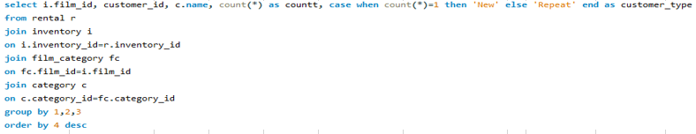
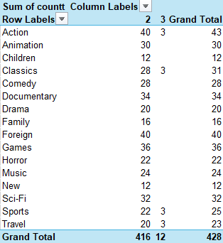
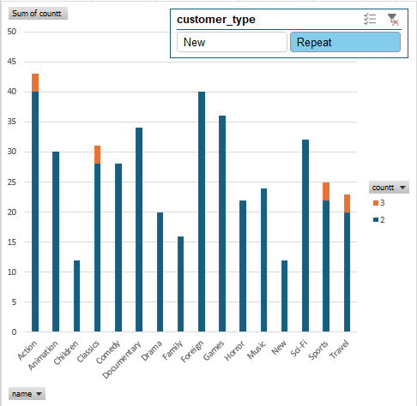
What are the purchasing patterns of new customers versus repeat customers?
Taking Film as point of reference, Repeated Customers have rented mostly from Action, Classics, Sports and Travel. Whereas New customers have only rented from Action and Travel

Slide 8
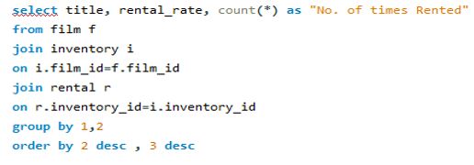
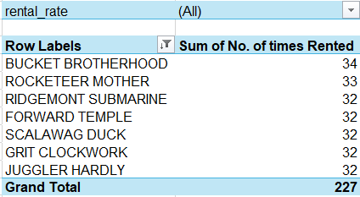
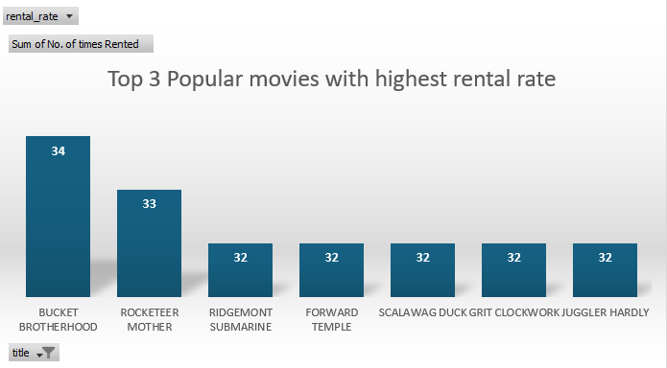
Which films have the highest rental rates and are most in demand?
The movie with the highest rental rate : 4.99 and which was rented the most (in demand) is Bucket Brotherhood

Slide 9
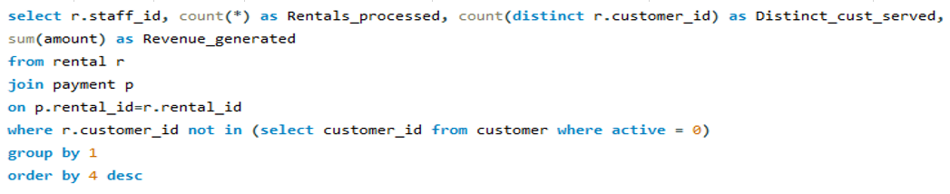
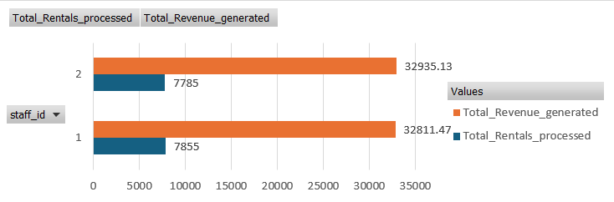
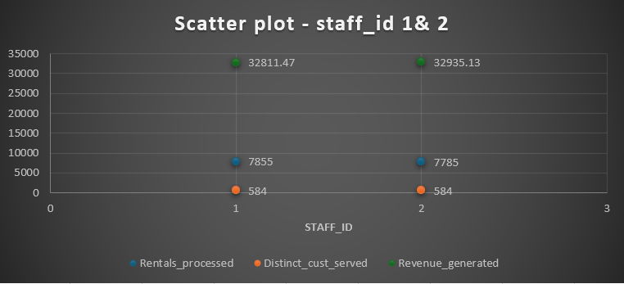
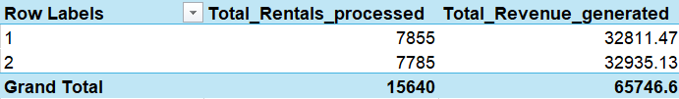
Are there correlations between staff performance and customer satisfaction?
As seen from the charts, having served the same numer of distinct active customers (584)- staff_id 1 has processed higher number of rentals, whereas staff_id 2 has generated higher rental income. So, we can say that there is no correlation between staff performance(attracting more distinct customers or processing more rentals or generating more revenue) and customer satisfaction.

Slide 10
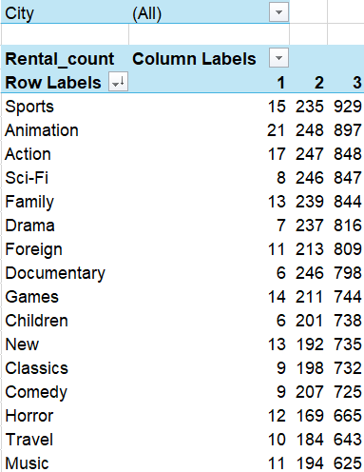
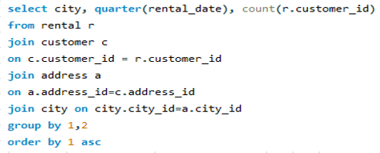
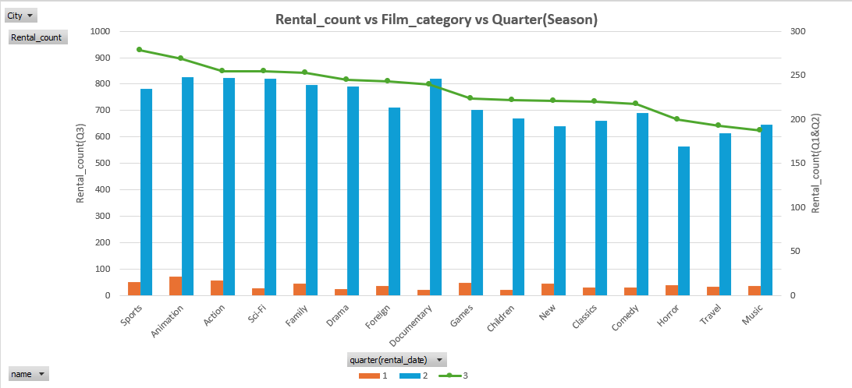
Are there seasonal trends in customer behavior across different locations?
Quarter 3(Q3) has shown the highest rental count for all cities combined as well as for individual cities too. Hence, Q3 season exhibits the most rental whereas Q1 season exhibits the least rentals

Slide 11
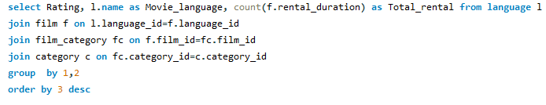
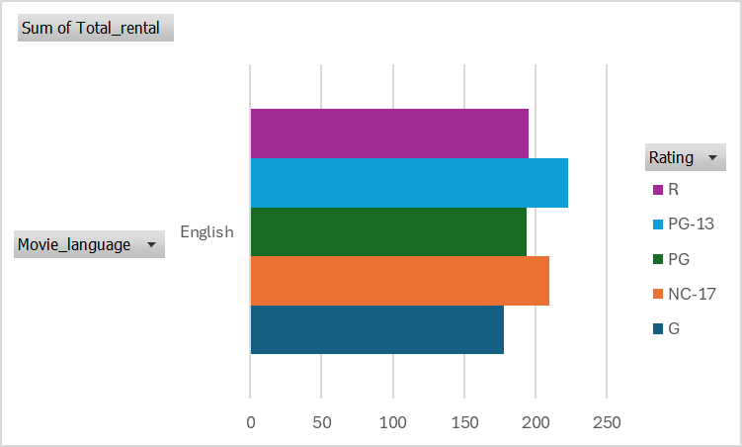
Are certain language films more popular among specific customer segments?
English is the only language available for movies in the dataset. So, it is the most popular language across all customer segments(calculated based on movie rating, as no age data given for the customers)

Slide 12
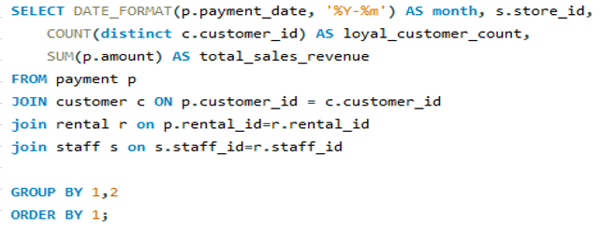
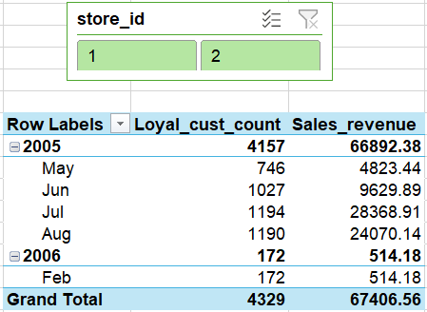
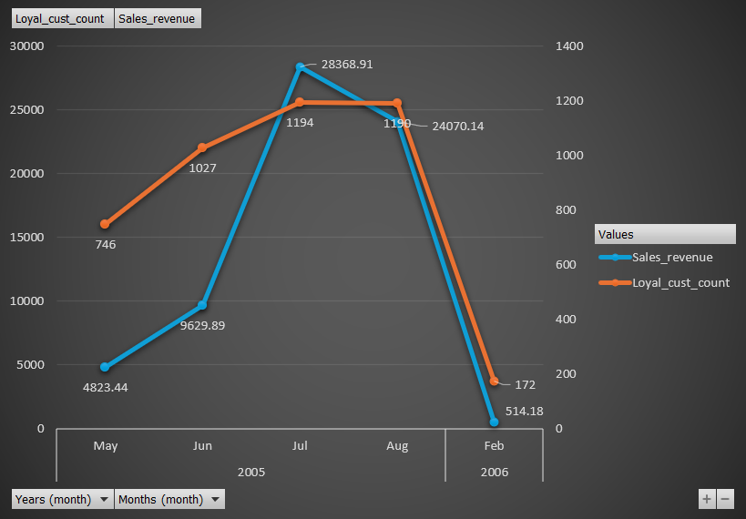
How does customer loyalty impact sales revenue over time?
As shown in the chart, with the increase in loyal customers - the sales revenue also increases over time.

Slide 13
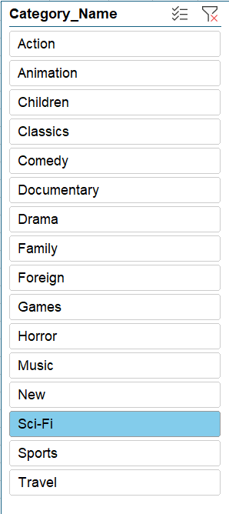
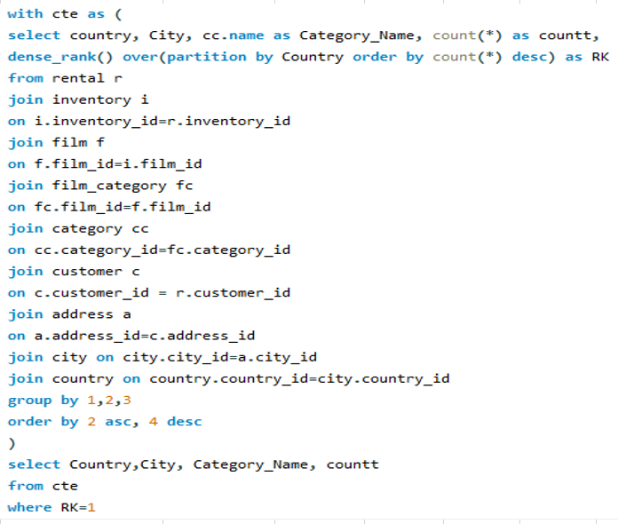
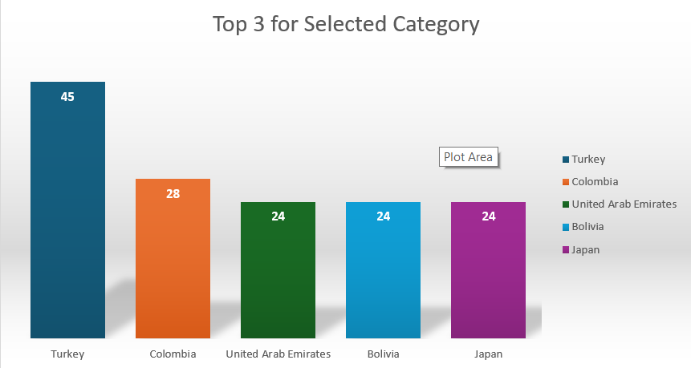
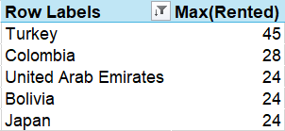
Are certain film categories more popular in specific locations?
The above graph shows the Top 3 Value Countries (based on max rental times in a country) for the selected movie category

Slide 14
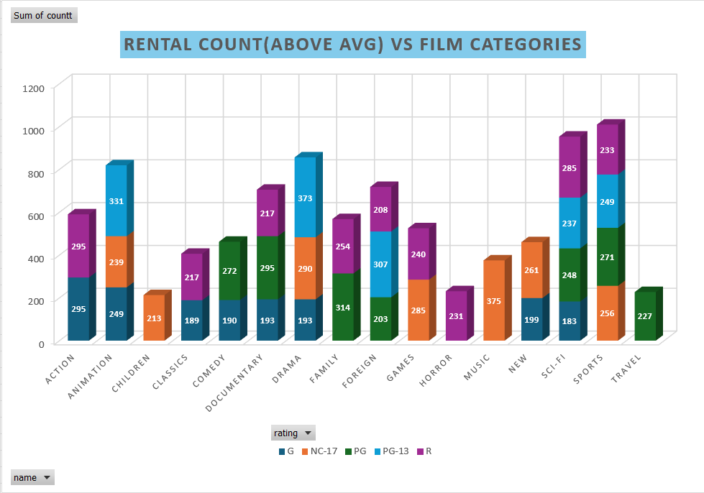
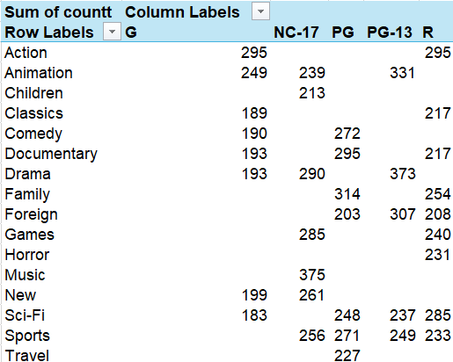
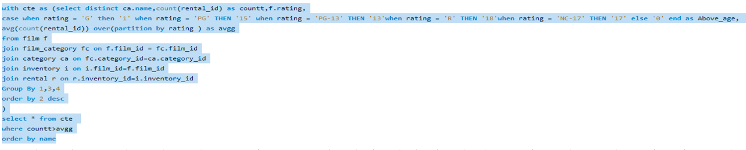
Do specific film categories attract different age groups of customers?
This chart represents the age groups (based on Ratings - for eg. R is for 18+) present for each Film Category, which has a rental count of more than the average rental count for that age group

Slide 15
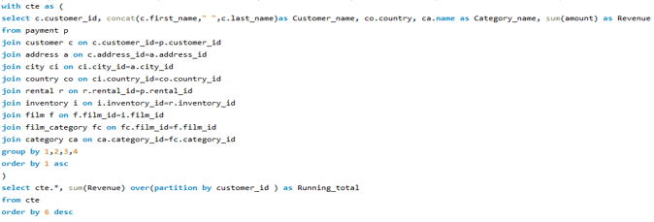
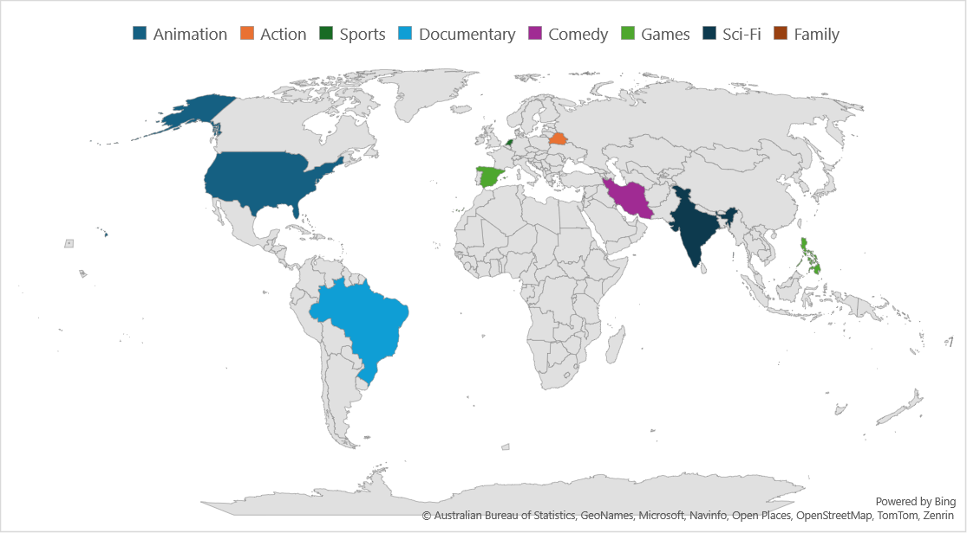
What are the demographics and preferences of the highest-spending customers?
The above pivot table shows the Top 10 high spending customers, their country, their most rented category, the amount they've paid for the most rented category and the overall rental amount they have paid.

Slide 16
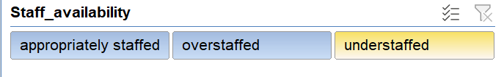
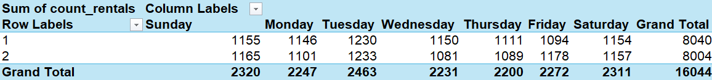
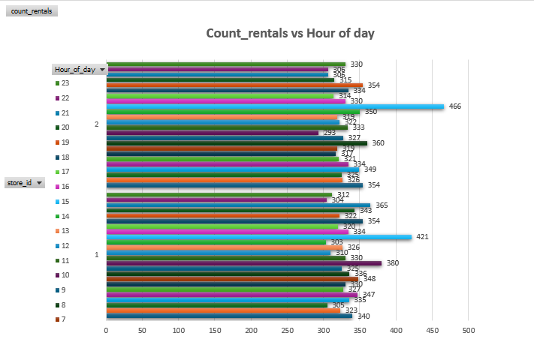
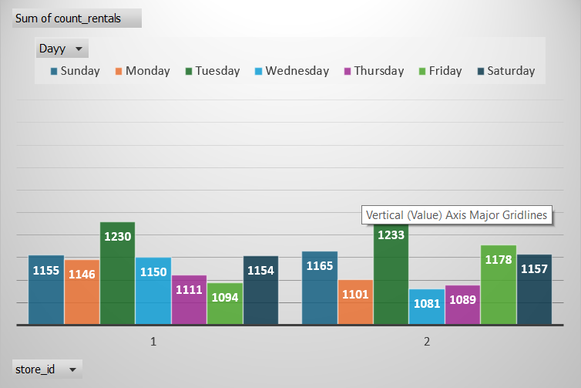
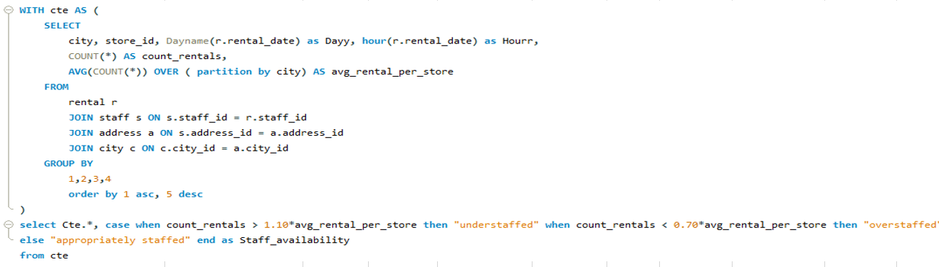
What are the busiest hours or days for each store location, and how does it impact staffing requirements?
The above pivot tables show the count of rentals as per day of the week and count of rentals as per the hour of day. For both store 1 and 2, Tuesday is the busiest with the greatest number of rentals and the busiest hour of day is 15(on Tuesday as well). Based on the rental count values over different hours(when compared with the average rentals/store), we have classified staffing into three categories: Understaffed, overstaffed and appropriately staffed

Slide 17
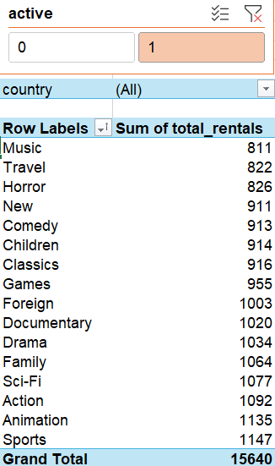
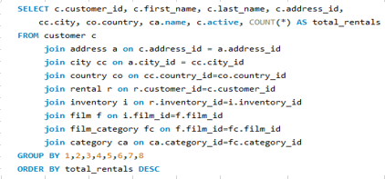
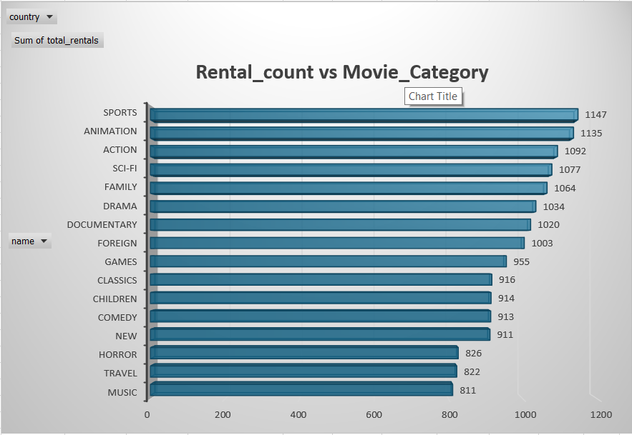
What are the cultural or demographic factors that influence customer preferences in different locations?
Upon selecting the country (from filter), we can see the Rental_Count distribution across different film categories.

Slide 18
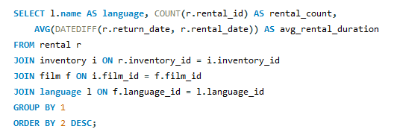
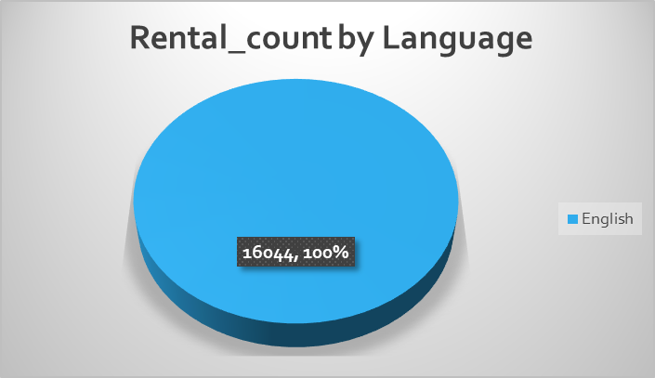
How does the availability of films in different languages impact customer satisfaction and rental frequency?
As seen from the Pie-chart, 100% of the movies rented were in English(as that’s the only language available in the dataset). So, insufficient data to evaluate the impact of language over customer satisfaction and rental frequency.

Slide 19
Solving EDA and Power BI Questions
Power BI questions and answers

Slide 20
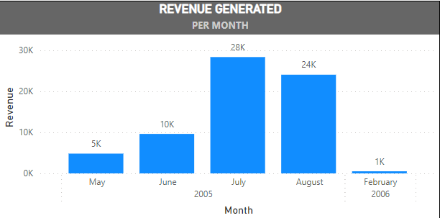
How does the sales revenue vary by month?
The above visual shows the variation in revenue for each available rental month.

Slide 21
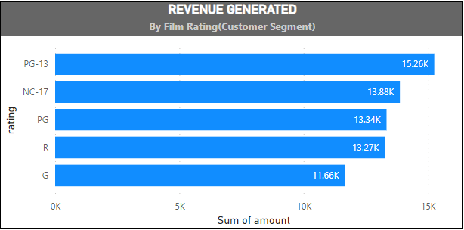
Which customer segments generate the highest sales?
Considering that the film rating is synonymous to or directly corresponds to Customer Segment (basis of age), the greatest contributor to Sales is by PG-13 segment.

Slide 22
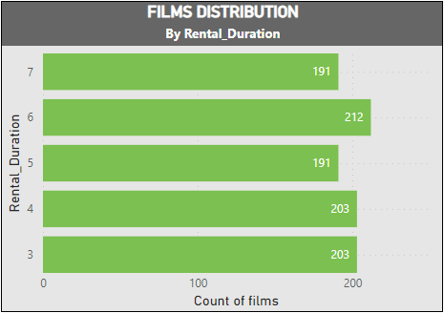
What is the distribution of films by rental duration?
The Stacked Bar Chart gives us a complete idea to understand the distribution of films by rental duration.

Slide 23
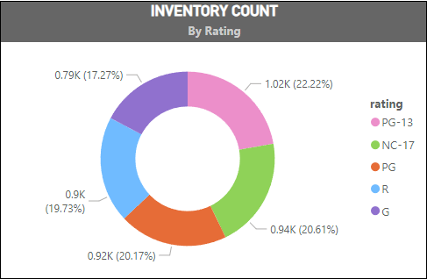
How does the inventory vary by film rating?
The slices of this donut chart give us a complete idea to understand partitions and percentage of inventory divided by rating of films.

Slide 24
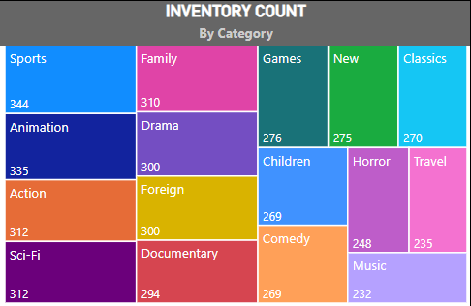
What is the breakdown of film categories in the inventory?
Each part of the Tree map gives us a complete idea to understand the count of inventory for each film category.

Slide 25
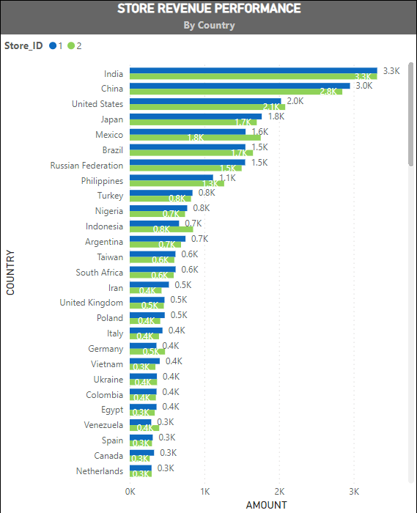
How does the store performance vary by location?
The Clustered Bar Chart gives us a complete idea to understand the earning revenue structure based on country for each store.

Slide 26
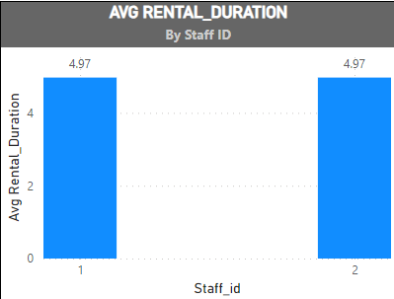
What is the average rental duration by staff member?
This Column Chart gives us a complete idea that the average rental duration of each staff are very same.

Slide 27
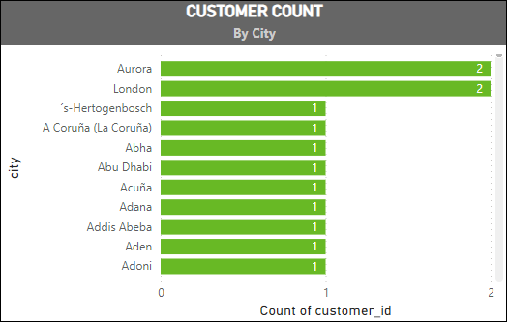
What is the distribution of customers across different cities?
The Stacked Bar Chart gives us the count of customers for each city.

Slide 28
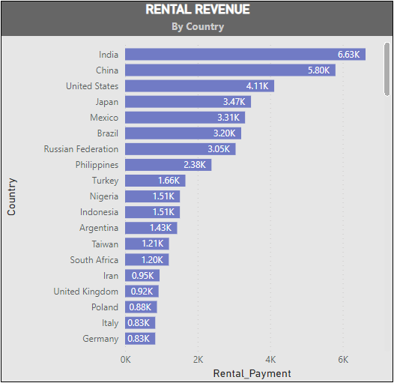
How does the rental revenue vary by country?
This Clustered Bar Chart helps us to understand the Revenue generated for the mentioned countries.

Slide 29
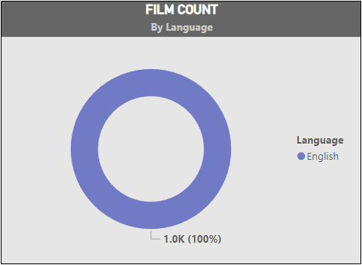
What is the distribution of films by language?
As clearly shown on the Donut Chart, all the films which were rented are in English language.

Slide 30
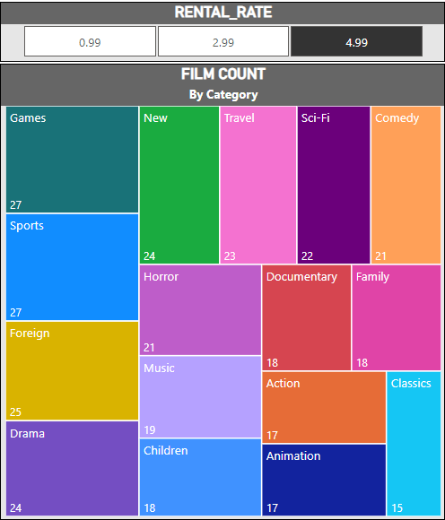
Which film categories have the highest rental rates?
This Tree Map shows that the movie category(s) with the highest rental rate (4.99) are Games and Sports.

Slide 31

How does the average rental duration vary by film category?
This Bar Chart gives us the average rental duration for each film category.

Slide 32


Dashboard Analysis
TITLE PAGE
INTRODUCTION PAGE
CHAKIT VERMA

Slide 33


Dashboard Analysis
REVENUE SUMMARY
CUSTOMER SUMMARY

Slide 34


Dashboard Analysis
INVENTORY SUMMARY
FILM SUMMARY

Slide 35


Dashboard Analysis
STAFF SUMMARY
STORE SUMMARY

Slide 36
Conclusion
The Sakila DVD rental store project reveals customer preferences and rental trends, guiding inventory management and marketing strategies. Insights into revenue and operational efficiency suggest avenues for growth and cost reduction. Implementing a recommendation system could enhance the customer experience, while digital solutions streamline operations.
Overall, leveraging data-driven strategies positions Sakila to thrive in the competitive entertainment market.

